Slide 1
Lecture 9: Generative Models

Slide 2
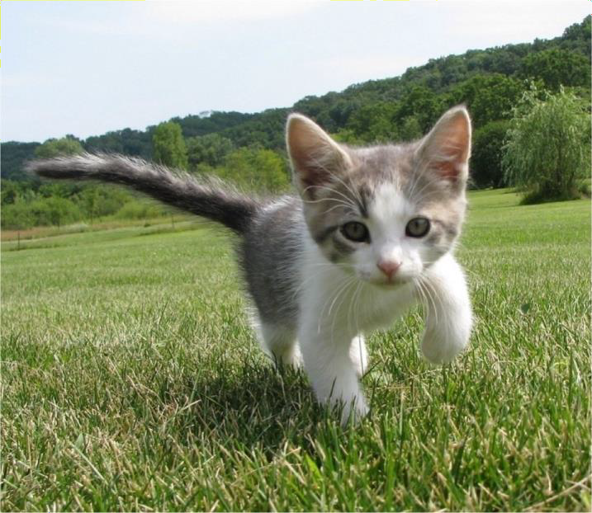
Supervised vs Unsupervised Learning
Supervised Learning
Classification
Data: (x, y)
x is data, y is label
Goal: Learn a function to map x -> y
Examples: Classification, regression, object detection, semantic segmentation, image captioning, etc.
2
Cat
This image is CC0 public domain

Slide 3
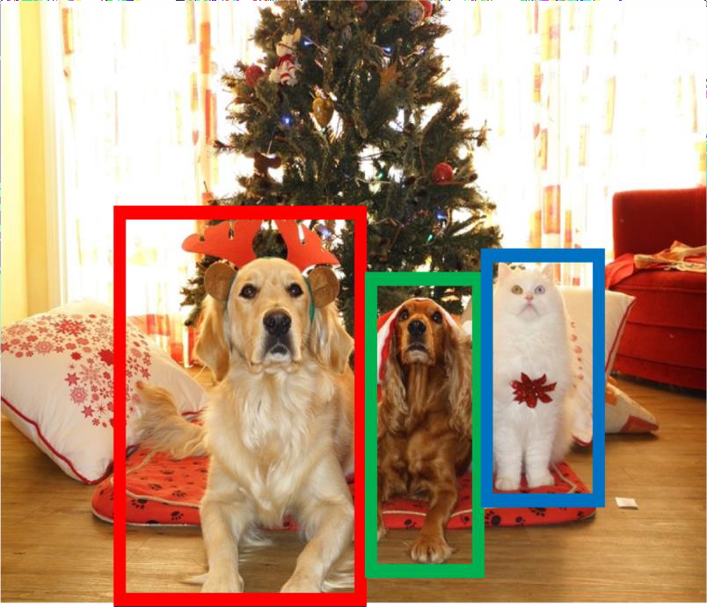
Supervised vs Unsupervised Learning
Supervised Learning
Object Detection
Data: (x, y)
x is data, y is label
Goal: Learn a function to map x -> y
Examples: Classification, regression, object detection, semantic segmentation, image captioning, etc.
5
DOG, DOG, CAT
This image is CC0 public domain

Slide 4
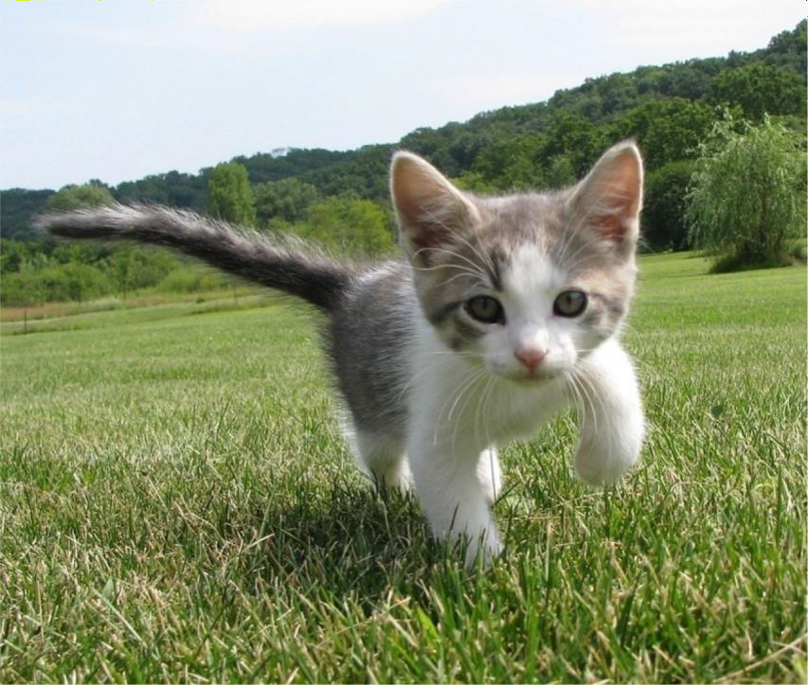
Supervised vs Unsupervised Learning
Supervised Learning
Semantic Segmentation
Data: (x, y)
x is data, y is label
Goal: Learn a function to map x -> y
Examples: Classification, regression, object detection, semantic segmentation, image captioning, etc.
4
GRASS, CAT, TREE, SKY

Slide 5
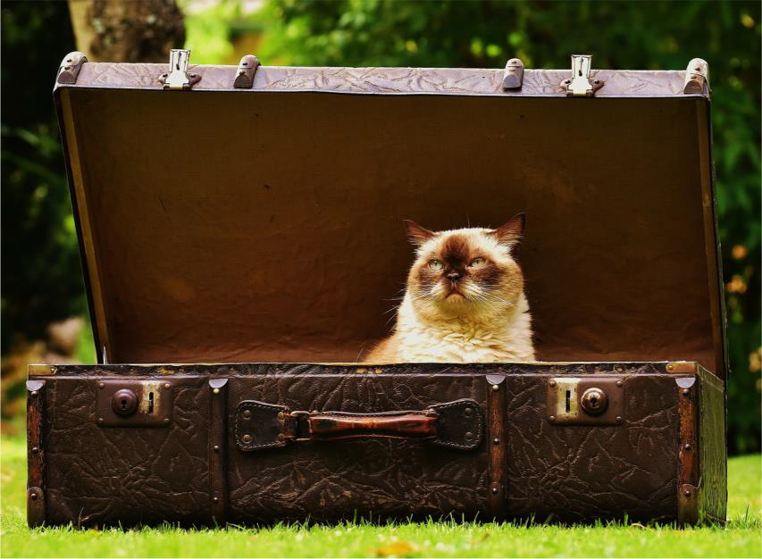
Supervised vs Unsupervised
Learning
Supervised Learning
Image captioning
Data: (x, y)
x is data, y is label
Goal: Learn a function to map x -> y
A cat sitting on a
suitcase on the floor
Examples: Classification, regression, object detection, semantic segmentation, image captioning, etc.
5
Caption generated using neuraltalk2
Image is CC0 Public domain.

Slide 6
Supervised vs Unsupervised
Learning
Supervised Learning Unsupervised Learning
Data: (x, y)
x is data, y is label
Data: x
Just data, no labels!
Goal: Learn a function to map x -> y
Goal: Learn some underlying hidden structure of the data
Examples: Classification, regression, object detection, semantic segmentation, image captioning, etc.
6
Examples: Clustering, dimensionality reduction, feature learning, density estimation, etc.

Slide 7
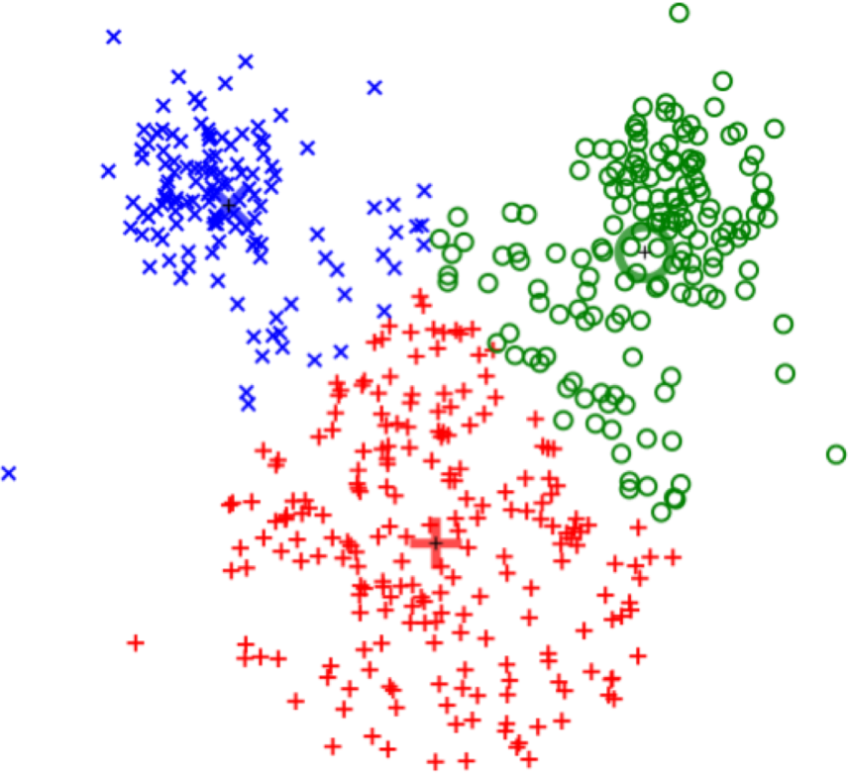
Supervised vs Unsupervised
Learning
Clustering
(e.g. K-Means)
Unsupervised Learning
Data: x
Just data, no labels!
Goal: Learn some underlying hidden structure of the data
Examples: Clustering, dimensionality reduction, feature learning, density estimation, etc.
This image is CC0 public domain
7
Notes:
In the future: Holy Grail of machine learning → machine learning models that employ unsupervised learning will learn features automatically over time about raw data with no labels! → it can create it’s own label based on data analysis (patterns found from clustering, etc..)
This type of machine learning would be the truest, purest form of artificial intelligence as it simulates human ability to naturally learn patterns and create labels.

Slide 8
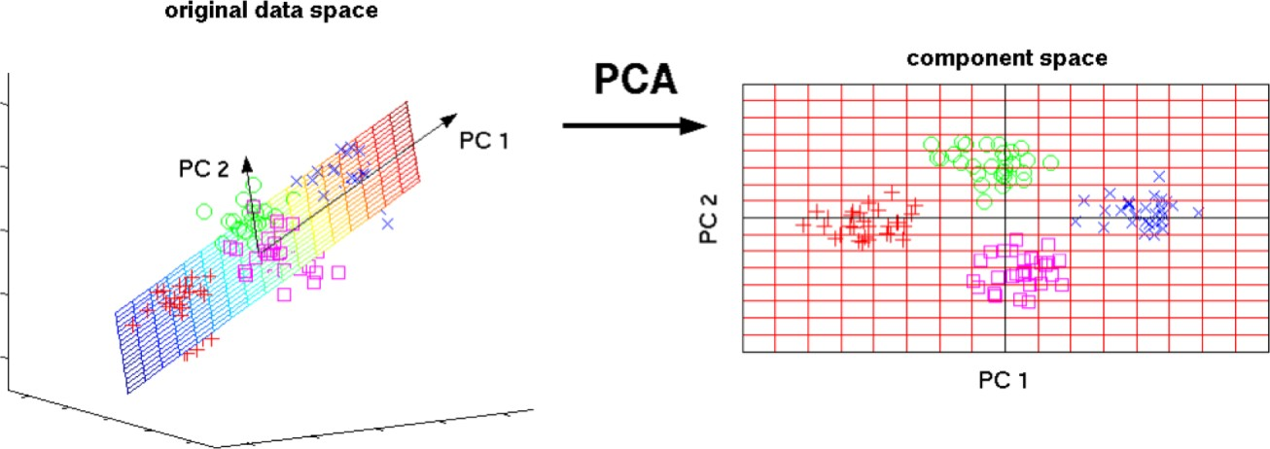
Supervised vs Unsupervised Learning
Unsupervised Learning
Dimensionality Reduction
(e.g. Principal Components Analysis)
Data: x
Just data, no labels!
Goal: Learn some underlying hidden structure of the data
3D
2D
Examples: Clustering, dimensionality reduction, feature learning, density estimation, etc.
This image from Matthias Scholz is CC0 public domain
0
Notes:
Dimensionality Reduction = dimension compression = think of linear algebra → you can ignore a dimension and focus on the other ones to reduce noise/complexity.
This can help find features easier in other dimensions rather than more complex analysis of many dimensions all at once.
If dimension reduction does not show a clear pattern, then your model may still not work as the data is too noisy (too much randomness/Uniformity; no features or no recognizable features!).
Can there be some proof written to prove that data must have some level of non-noise (can we quantify this?) in order to be distinguishable/able to find a pattern?

Slide 9
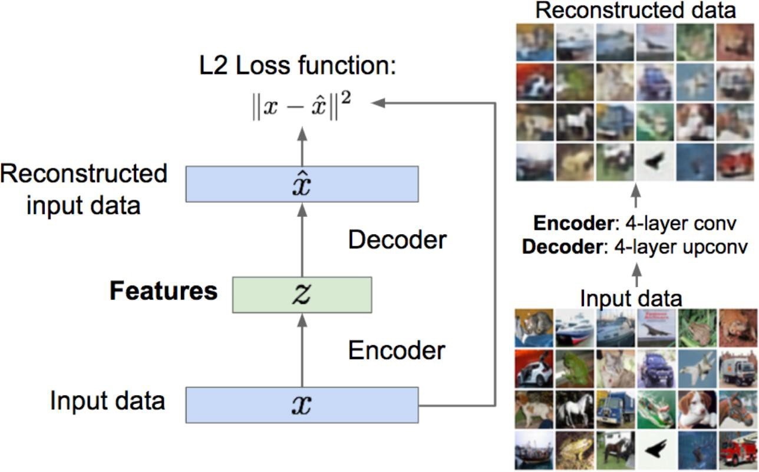
Supervised vs Unsupervised Learning
Feature Learning (e.g. autoencoders)
Unsupervised Learning
Data: x
Just data, no labels!
Goal: Learn some underlying hidden structure of the data
Examples: Clustering, dimensionality reduction, feature learning, density estimation, etc.
Notes:
Use unlabeled data to train the feature extraction module, z.

Slide 10
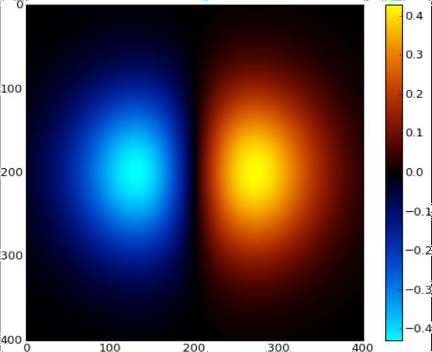
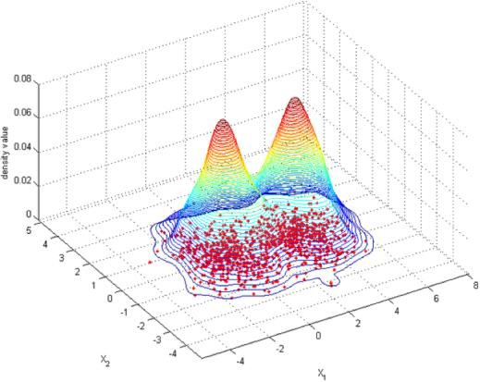
Supervised vs Unsupervised
Learning
Density Estimation
Unsupervised Learning
Data: x
Just data, no labels!
Goal: Learn some underlying hidden structure of the data
Examples: Clustering, dimensionality reduction, feature learning, density estimation, etc.
Images left and right are CC0 public domain

Slide 11
Supervised vs Unsupervised
Learning
Supervised Learning Unsupervised Learning
Data: (x, y)
x is data, y is label
Data: x
Just data, no labels!
Goal: Learn a function to map x -> y
Goal: Learn some underlying hidden structure of the data
Examples: Classification, regression, object detection, semantic segmentation, image captioning, etc.
Examples: Clustering, dimensionality reduction, feature learning, density estimation, etc.
Notes:
Keep in mind: generative models rely on unsupervised learning.

Slide 12

Discriminative vs Generative Models
Discriminative Model: Learn a probability distribution p(y|x)
Data: x
Generative Model: Learn a probability distribution p(x)
Label: y
Cat
Conditional Generative Model: Learn p(x|y)
Notes:
Thinks about that name: Discriminative Model → makes sense because you are trying to learn features by using bias from learning to discriminate between labels (i.e., dog v cat) through the use of probability.
Generative model: simply tells you how likely an image is to show up.
Conditional generative model: try to learn a P dist. Over images condition on label y. (it is reverse of discriminative model).

Slide 13
Discriminative vs Generative Models
Probability Recap:
Density Function
p(x) assigns a positive number to each possible x; higher numbers mean x is more likely
Discriminative Model: Learn a probability distribution p(y|x)
Data: x
Generative Model: Learn a probability distribution p(x)
Density functions are
normalized:
Label: y
Cat
න 𝑝 𝑥 𝑑 𝑥 = 1
𝑋
Different values of x
compete for density
Conditional Generative Model: Learn p(x|y)
Notes:
Normalized = take p function and integrate it to 1 (all p add to equal 1).
Because of normalization (a key step), Different values of x compete for density since if one value has higher density, then it means it must take away from (lower) another value(s) density.

Slide 14
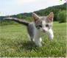
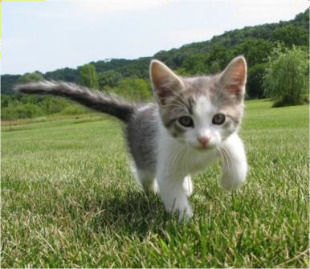
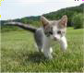
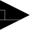
Discriminative vs Generative Models
P(cat|. )
P(dog|. )
Discriminative Model: Learn a probability distribution p(y|x)
Data: x
Generative Model: Learn a probability distribution p(x)
Conditional Generative Model: Learn p(x|y)
Density functions
are normalized:
Density Function
p(x) assigns a positive number
to each possible x; higher
numbers mean x is more likely
න 𝑝 𝑥 𝑑 𝑥 = 1
𝑋
Different values of x
compete for density

Slide 15
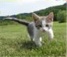
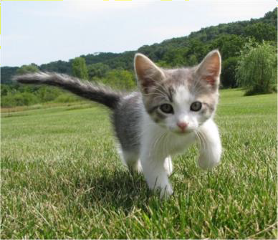

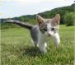
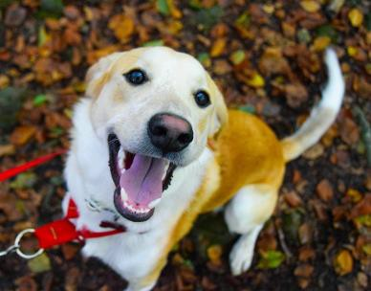
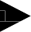
Discriminative vs Generative
Models
P(cat|. )
Discriminative Model: Learn a probability distribution p(y|x)
P(dog|. )
Generative Model: Learn a probability distribution p(x)
P(dog| )
P(cat| )
Discriminative model: the possible labels for
each input ”compete” for probability mass.
But no competition between images
Conditional Generative Model: Learn p(x|y)
Dog image is CC0 Public Domain
Notes:
Notice dog label has to compete with the cat label
This is how it always works, all values/labels must compete with each other due to the normalization.
But what will happen if we feed an image (p x|some image that does not fit the data set) for discriminative model? See next slide.
It will still give an output based on the labels used in the model.

Slide 16
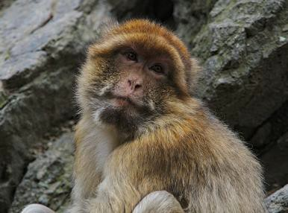
Discriminative vs Generative Models
Discriminative Model: Learn a probability distribution p(y|x)
P(cat| )
P(dog| )
Generative Model: Learn a probability distribution p(x)
P(dog| )
P(cat )
Discriminative model: No way for the model to handle unreasonable inputs; it must give label distributions for all images
|
Conditional Generative Model: Learn p(x|y)
Monkey image is CC0 PublicDomain

Slide 17
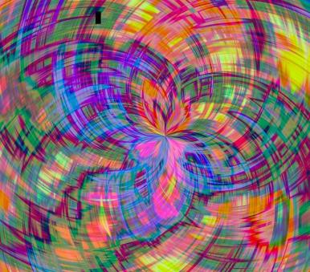
Discriminative vs Generative Models
Discriminative Model: Learn a probability distribution p(y|x)
P(cat| )
P(dog| )
Generative Model: Learn a probability distribution p(x)
P(dog| )
P(cat| )
Conditional Generative Model: Learn p(x|y)
Discriminative model: No way for the model to handle unreasonable inputs; it must give label distributions for all images
Monkey image is CC0 PublicDomain
Abstract image is free to useunder the Pixabay license
Notes:
Adversarial attacks possible with discriminative models: mess up the model/lower accuracy because when you do the attack, the model can be trained with the unreasonable image because the model is still forced to output a normalized distribution based on the label space → no capacity to know when an unreasonable image input is passed in.

Slide 18
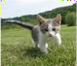
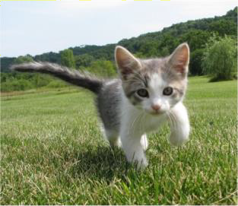
Discriminative vs Generative Models
P( )
Cat image is CC0 public domain
Dog image is CC0 Public Domain
Monkey image is CC0 Public Domain
Abstract image is free to use under the Pixabay license
Discriminative Model: Learn a probability distribution p(y|x)
P( )
P( )
P( )
Generative Model: Learn a probability distribution p(x)
…
Generative model: All possible images compete
with each other for probability mass
Conditional Generative Model: Learn p(x|y)
Notes:
P(x) is a p distribution of all possible images in the data set.
This is a really hard problem: not solved yet because it is hard to get the density function to tell you which image is more likely than the other images in the data set.
Generative model needs a lot more data to train on.

Slide 19
Discriminative vs Generative Models
P( )
Cat image is CC0 public domain
Dog image is CC0 Public Domain
Monkey image is CC0 Public Domain
Abstract image is free to use under the Pixabay license
Discriminative Model: Learn a probability distribution p(y|x)
P( )
P( )
P( )
Generative Model: Learn a probability distribution p(x)
…
Generative model: All possible images compete
with each other for probability mass
Conditional Generative Model: Learn p(x|y)
Requires deep image understanding! Is a dog more likely to sit or stand? How about 3-legged dog vs 3-armed monkey?
Notes:
Requires deep image understanding! Is a dog more likely to sit or stand? How about 3-legged dog vs 3-armed monkey?
Can maybe train another model to get this information.

Slide 20
Discriminative vs Generative Models
P( )
Cat image is CC0 public domain
Dog image is CC0 Public Domain
Monkey image is CC0 Public Domain
Abstract image is free to use under the Pixabay license
Discriminative Model: Learn a probability distribution p(y|x)
P( )
P( )
P( )
Generative Model: Learn a probability distribution p(x)
…
Generative model: All possible images compete
with each other for probability mass
Conditional Generative Model: Learn p(x|y)
Model can “reject” unreasonable inputs by assigning them small values
22

Slide 21
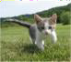
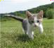
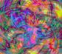

Discriminative vs Generative Models
P( |cat)
Cat image is CC0 public domain
Dog image is CC0 Public Domain
Monkey image is CC0 Public Domain
Abstract image is free to use under the Pixabay license
Discriminative Model: Learn a probability distribution p(y|x)
P( |cat)
P( |dog)
P( |cat)
P( |cat)
P( |dog)
P( |dog)
P( |dog)
Generative Model: Learn a probability distribution p(x)
…
Conditional Generative Model: Learn p(x|y)
Conditional Generative Model: Each possible label induces a competition among all images
Notes:
Then compare P generated of two inputs x to their respective P for a given y (label).
Generative models are designed to describe how the images were generated, not merely classification through more distinct features (a lot less features than with generative models) as with Discriminative models.

Slide 22
Cat image is CC0 public domain
Dog image is CC0 Public Domain
Monkey image is CC0 Public Domain
Abstract image is free to use under the Pixabay license
Discriminative vs Generative Models
Recall Bayes’ Rule:
Discriminative Model: Learn a probability distribution p(y|x)
𝑃 𝑥
𝑦) = ^{𝑃 𝑦 𝑥)} 𝑃(𝑥)
Generative Model: Learn a probability distribution p(x)
𝑃 𝑦
Conditional Generative Model: Learn p(x|y)

Slide 23
Cat image is CC0 public domain
Dog image is CC0 Public Domain
Monkey image is CC0 Public Domain
Abstract image is free to use under the Pixabay license
Discriminative vs Generative Models
Recall Bayes’ Rule:
Discriminative Model: Learn a probability distribution p(y|x)
Discriminative Model
(Unconditional) Generative Model
𝑃 𝑦 𝑥)
𝑃 𝑥 𝑦)
=
𝑃(𝑥)
Generative Model: Learn a probability distribution p(x)
𝑃 𝑦
Conditional Generative Model
Prior over labels
Conditional Generative Model: Learn p(x|y)
We can build a conditional generative
model from other components!
Notes:
Prior over labels = probability from the P distribution of labels. (i.e. 80 dogs, 20 cats → if y=cats then P(y)=.2)

Slide 24
What can we do with a discriminative model?
Discriminative Model: Learn a probability distribution p(y|x)
Generative Model: Learn a probability distribution p(x)
Conditional Generative Model:Learn p(x|y)
Assign labels to data
Feature learning (with labels)

Slide 25
What can we do with a generative model?
Discriminative Model: Learn a probability distribution p(y|x)
Generative Model: Learn a probability distribution p(x)
Conditional Generative Model: Learn p(x|y)
Assign labels to data
Feature learning (with labels)
Detect outliers
Feature learning (without labels)
Sample to generate new data

Slide 26
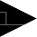
What can we do with a generative model?
Discriminative Model: Learn a probability distribution p(y|x)
Generative Model: Learn a probability distribution p(x)
Conditional Generative Model: Learn p(x|y)
Assign labels to data
Feature learning (supervised)
Detect outliers
Feature learning (unsupervised) Sample to generate new data
Assign labels, while rejecting outliers! Generate new data conditioned on input labels

Slide 27
Taxonomy of Generative Models
Generative models
Figure adapted from Ian Goodfellow, Tutorial on Generative Adversarial Networks, 2017.

Slide 28
Taxonomy of Generative Models
Model does not explicitly compute p(x), but can sample from p(x)
Model can
compute p(x)
Generative models
Explicit density
Implicit density
Figure adapted from Ian Goodfellow, Tutorial on Generative Adversarial Networks, 2017.

Slide 29
Taxonomy of Generative Models
Model does not explicitly compute p(x), but can sample from p(x)
Model can
compute p(x)
Generative models
Explicit density
Implicit density
Can compute
approximation to p(x)
Tractable density
Approximate density
Can compute p(x)
Autoregressive
NADE / MADE
NICE / RealNVP
Glow
Ffjord
Figure adapted from Ian Goodfellow, Tutorial on Generative Adversarial Networks, 2017.

Slide 30
Taxonomy of Generative Models
Model does not explicitly compute p(x), but can sample from p(x)
Model can
compute p(x)
Generative models
Explicit density
Implicit density
Can compute
approximation to p(x)
Tractable density
Approximate density
Can compute p(x)
Autoregressive
NADE / MADE
NICE / RealNVP
Glow
Ffjord
Variational
Markov Chain
Variational Autoencoder
Boltzmann Machine
Figure adapted from Ian Goodfellow, Tutorial on Generative Adversarial Networks, 2017.

Slide 31
Taxonomy of Generative Models
Model does not explicitly compute p(x), but can sample from p(x)
Model can
compute p(x)
Generative models
Explicit density
Implicit density
Can compute
approximation to p(x)
Tractable density
Approximate density
Markov Chain
Direct
Can compute p(x)
GSN
Generative Adversarial Networks (GANs)
Autoregressive
NADE / MADE
NICE / RealNVP
Glow
Ffjord
Variational
Markov Chain
Variational Autoencoder
Boltzmann Machine
Figure adapted from Ian Goodfellow, Tutorial on Generative Adversarial Networks, 2017.

Slide 32
Taxonomy of Generative Models
Model does not explicitly compute p(x), but can sample from p(x)
Model can
compute p(x)
Generative models
Explicit density
Implicit density
Can compute
approximation to p(x)
Tractable density
Approximate density
Markov Chain
Direct
Can compute p(x)
GSN
Generative Adversarial
Networks (GANs)
Autoregressive
-
NADE / MADE
NICE / RealNVP
Glow
Ffjord
Variational
Markov Chain
We will talk about these
Variational Autoencoder
Boltzmann Machine
Figure adapted from Ian Goodfellow, Tutorial on Generative Adversarial Networks, 2017.
Notes:
Explicit density:
Example: Gaussian Mixture Model (GMM)
Tractable means there is the analytical solution.
Boltzmann Machine is very liked among mathematicians and physicist (used for analysis of quantum mechanics)
Direct → GANs → stable diffusion.

Slide 33
Variational Autoencoders

Slide 34
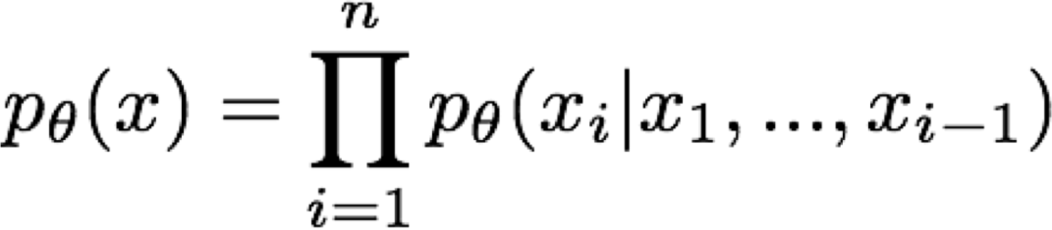
Variational Autoencoders
Typical density models explicitly parameterize density function with a neural network, so we can train to maximize likelihood of training data:
Variational Autoencoders (VAE) define an intractable density that we cannot explicitly compute or optimize
But we will be able to directly optimize a lower bound on the density

Slide 35
Variational Autoencoders

Slide 36
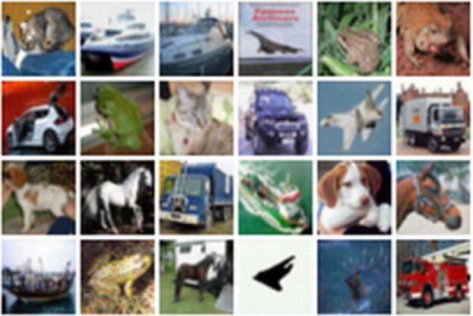
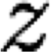
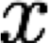
(Regular, non-variational) Autoencoders
Unsupervised method for learning feature vectors from raw data x, without any labels
Features should extract useful
information (maybe object identities, properties, scene type, etc) that we can use for downstream tasks
Originally: Linear + nonlinearity (sigmoid)
Later: Deep, fully-connected
Later: ReLU CNN
Features
Encoder
Input data

Slide 37
(Regular, non-variational) Autoencoders
Problem: How can we learn this feature transform from raw data?
Features should extract useful
information (maybe object identities, properties, scene type, etc) that we can use for downstream tasks
But we can’t observe features!
Originally: Linear + nonlinearity (sigmoid)
Later: Deep, fully-connected
Later: ReLU CNN
Features
Encoder
Input data
Input Data
Notes:
Train model to reconstruct the original training data.

Slide 38
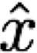
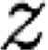
(Regular, non-variational) Autoencoders
Problem: How can we learn this feature transform from raw data? Idea: Use the features to reconstruct the input data with a decoder “Autoencoding” = encoding itself
Reconstructed
input data
Decoder
Features
Encoder
Input data
Input Data
Notes:
Both the encoder and decoder are Neural Networks, usually CNN
So we want to minimize the difference between the input data and the reconstructed input data that was generated based on the features extracted by encoder.
Of course encoder and decoder cannot be trivial solution: weights that simply will make output equal input so that loss = 0.
This is achieved by making dimensionality different → we reduce dimensionality into features z, so you will never get the same exact output as input data since we will not have enough features to make encoder and decoder exact (an identity function).

Slide 39
(Regular, non-variational) Autoencoders
Loss: L2 distance between input and reconstructed data.
Loss Function
Does not use any
labels! Just raw data!
𝑥Ƹ − 𝑥
2
2
Reconstructed
input data
Decoder
Features
Encoder
Input data
Input Data

Slide 40
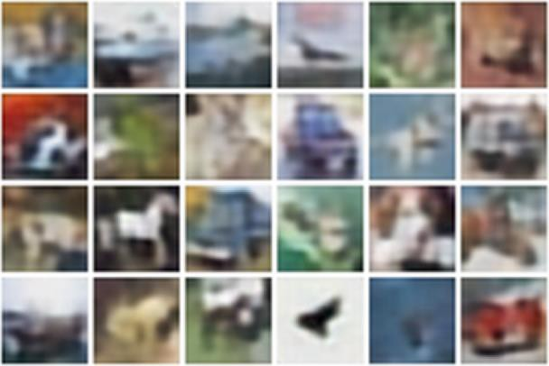
(Regular, non-variational) Autoencoders
Reconstructed data
Loss: L2 distance between input and reconstructed data.
Loss Function
Does not use any
labels! Just raw data!
𝑥Ƹ − 𝑥 ²
2
Decoder:
4 tconv layers
Encoder:
4 conv layers
Reconstructed
input data
Decoder
Features
Encoder
Input data
Input Data

Slide 41
(Regular, non-variational) Autoencoders
Reconstructed data
Loss: L2 distance between input and reconstructed data.
Loss Function
Does not use any
labels! Just raw data!
𝑥Ƹ − 𝑥 ²
2
Decoder:
4 tconv layers
Encoder:
4 conv layers
Reconstructed
input data
Decoder
Features need to be lower dimensional than the data
Features
Encoder
Input data
Input Data

Slide 42
(Regular, non-variational) Autoencoders
After training, throw away decoder and use encoder for a downstream task
Reconstructed
input data
Decoder
After training,
throw away decoder
Features
Encoder
Input data

Slide 43
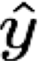
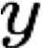
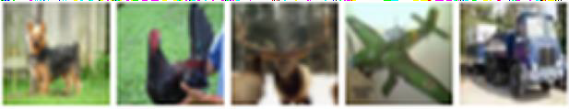
(Regular, non-variational) Autoencoders
After training, throw away decoder and use encoder for a downstream task
Loss function (Softmax, etc)
Encoder can be used to initialize a supervised model
Predicted Label
Fine-tune encoder jointly with classifier
bird plane dog deer
Classifier
truck
Features
Encoder
Train for final task (sometimes with small data)
Input data
69

Slide 44
(Regular, non-variational)
Autoencoders
Autoencoders learn latent features for data without any labels!
Can use features to initialize a supervised model
Not probabilistic: No way to sample new data from learned model
Reconstructed
input data
Decoder
Features
Encoder
Input data
Notes:
In machine learning, a latent space refers to a compressed representation of data that captures its underlying structure or patterns. Specifically, a latent space is a lower-dimensional space that is learned from the original high-dimensional data, such that similar data points in the original space are mapped to nearby points in the latent space.
Latent spaces are often learned using unsupervised learning techniques, such as autoencoders or variational autoencoders. These models are trained to encode the input data into a compressed representation (i.e., the latent space) and then decode it back to the original data. During this process, the model learns to preserve important features of the data while discarding irrelevant or redundant information.
Once the latent space has been learned, it can be used for a variety of tasks, such as data compression, data visualization, or data generation. For example, in data compression, the original high-dimensional data can be compressed into the lower-dimensional latent space, resulting in a smaller representation that requires less storage or bandwidth. In data generation, new data points can be generated by sampling from the distribution of points in the latent space and decoding them back into the original space.
Overall, the latent space is a useful tool in machine learning for discovering the underlying structure or patterns in complex data and enabling a variety of downstream applications.

Slide 45
Variational Autoencoders
Kingma and Welling, Auto-Encoding Variational Beyes, ICLR 2014

Slide 46
Variational Autoencoders
Probabilistic spin on autoencoders:
Learn latent features z from raw data
Sample from the model to generate new data

Slide 47
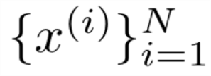
Variational Autoencoders
Probabilistic spin on autoencoders:
Learn latent features z from raw data
Sample from the model to generate new data
Assume training data is generated from unobserved (latent) representation z
Intuition: x is an image, z is latent factors used to generate x: attributes, orientation, etc.

Slide 48
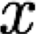
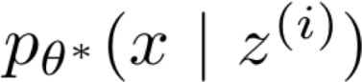
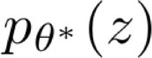

Variational Autoencoders
Probabilistic spin on autoencoders:
Learn latent features z from raw data
Sample from the model to generate new data
After training, sample new data like this:
Sample from conditional
Sample z from prior
Assume training data is generated from unobserved (latent) representation z
Intuition: x is an image, z is latent factors used to generate x: attributes, orientation, etc.
Notes:
Map a distribution to a distribution, and a feature vector to an image.

Slide 49
Variational Autoencoders
Probabilistic spin on autoencoders:
Learn latent features z from raw data
Sample from the model to generate new data
After training, sample new data like this:
Sample from conditional
Sample z from prior
Assume training data is generated from unobserved (latent) representation z
Intuition: x is an image, z is latent factors used to generate x: attributes, orientation, etc.
Assume simple prior p(z), e.g. Gaussian

Slide 50
Variational Autoencoders
Probabilistic spin on autoencoders:
Learn latent features z from raw data
Sample from the model to generate new data
After training, sample new data like this:
Sample from conditional
Sample z
from prior
Assume training data is generated from unobserved (latent) representation z
Intuition: x is an image, z is latent factors used to generate x: attributes, orientation, etc.
Assume simple prior p(z), e.g.
Gaussian
Represent p(x|z) with a neural network (Similar to decoder from autencoder)

Slide 51
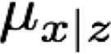
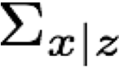
Variational Autoencoders
Decoder must be probabilistic: Decoder inputs z, outputs mean μ_{x|z} and (diagonal) covariance ∑_{x|z}
Sample x from Gaussian with mean
μ_{x|z} and (diagonal) covariance ∑_{x|z}
Sample from
conditional
Sample z
from prior
Assume training data is generated from unobserved (latent) representation z
Intuition: x is an image, z is latent factors used to generate x: attributes, orientation, etc.
Assume simple prior p(z), e.g.
Gaussian
Represent p(x|z) with a neural network (Similar to decoder from autoencoder)

Slide 52
Variational Autoencoders
Decoder must be probabilistic: Decoder inputs z, outputs mean μ_{x|z} and (diagonal) covariance ∑_{x|z}
Sample x from Gaussian with mean
μ_{x|z} and (diagonal) covariance ∑_{x|z}
Sample from
conditional
Sample z
from prior
Assume training data is generated from unobserved (latent) representation z
How to train this model?
Basic idea: maximize likelihood of data
If we could observe the z for each x, then could train a conditional generative model p(x|z)

Slide 53
Variational Autoencoders
Decoder must be probabilistic: Decoder inputs z, outputs mean μ_{x|z} and (diagonal) covariance ∑_{x|z}
Sample x from Gaussian with mean
μ_{x|z} and (diagonal) covariance ∑_{x|z}
Sample from
conditional
Sample z
from prior
Assume training data is generated from unobserved (latent) representation z
How to train this model?
Basic idea: maximize likelihood of data
We don’t observe z, so need to marginalize:
𝑝_{𝜃} 𝑥 = ∫ 𝑝_{𝜃} 𝑥, 𝑧 𝑑𝑧 = ∫ 𝑝_{𝜃} 𝑥|𝑧 𝑝_{𝜃}(𝑧)𝑑𝑧

Slide 54
Variational Autoencoders
Decoder must be probabilistic: Decoder inputs z, outputs mean μ_{x|z} and (diagonal) covariance ∑_{x|z}
Sample x from Gaussian with mean
μ_{x|z} and (diagonal) covariance ∑_{x|z}
Sample from
conditional
Sample z
from prior
Assume training data is generated from unobserved (latent) representation z
How to train this model?
Basic idea: maximize likelihood of data
We don’t observe z, so need to marginalize:
𝑝_{𝜃} 𝑥 = ∫ 𝑝_{𝜃} 𝑥, 𝑧 𝑑𝑧 = ∫ 𝑝_{𝜃} 𝑥|𝑧 𝑝_{𝜃}(𝑧)𝑑𝑧
Ok, can compute this with decoder network

Slide 55
Variational Autoencoders
Decoder must be probabilistic: Decoder inputs z, outputs mean μ_{x|z} and (diagonal) covariance ∑_{x|z}
Sample x from Gaussian with mean
μ_{x|z} and (diagonal) covariance ∑_{x|z}
Sample from
conditional
Sample z
from prior
Assume training data is generated from unobserved (latent) representation z
How to train this model?
Basic idea: maximize likelihood of data
We don’t observe z, so need to marginalize:
𝑝_{𝜃} 𝑥 = ∫ 𝑝_{𝜃} 𝑥, 𝑧 𝑑𝑧 = ∫ 𝑝_{𝜃} 𝑥|𝑧 𝑝_{𝜃}(𝑧)𝑑𝑧
Ok, we assumed Gaussian prior for z

Slide 56
Variational
Autoencoders
Decoder must be probabilistic: Decoder inputs z, outputs mean μ_{x|z} and (diagonal) covariance ∑_{x|z}
Assume training data is generated from unobserved (latent) representation z
Sample x from Gaussian with mean
μ_{x|z} and (diagonal) covariance ∑_{x|z}
How to train this model?
Sample from
conditional
Basic idea: maximize likelihood of data
We don’t observe z, so need to marginalize:
Sample z
from prior
𝑝_{𝜃} 𝑥
= ∫ 𝑝_{𝜃} 𝑥, 𝑧 𝑑𝑧 = !∫ 𝑝_{𝜃} 𝑥|𝑧 𝑝_{𝜃}(𝑧)𝑑𝑧
Problem: Impossible to integrate over all z!

Slide 57
Variational Autoencoders
Decoder must be probabilistic: Decoder inputs z, outputs mean μ_{x|z} and (diagonal) covariance ∑_{x|z}
Recall 𝑝 𝑥, 𝑧
= 𝑝 𝑥
𝑧 𝑝 𝑧
= 𝑝 𝑧
𝑥 𝑝 𝑥
Assume training data is generated from unobserved (latent) representation z
Sample x from Gaussian with mean
μ_{x|z} and (diagonal) covariance ∑_{x|z}
How to train this model?
Sample from
conditional
Basic idea: maximize likelihood of data
Another idea: Try Bayes’ Rule:
₌ 𝑝_{θ} 𝑥 𝑧)𝑝 _{θ} 𝑧
𝑝 _{θ} 𝑧 𝑥)
Sample z
from prior
𝑝 𝑥
θ

Slide 58
Variational Autoencoders
Decoder must be probabilistic: Decoder inputs z, outputs mean μ_{x|z} and (diagonal) covariance ∑_{x|z}
Recall 𝑝 𝑥, 𝑧
= 𝑝 𝑥
𝑧 𝑝 𝑧
= 𝑝 𝑧
𝑥 𝑝 𝑥
Assume training data is generated from unobserved (latent) representation z
Sample x from Gaussian with mean
μ_{x|z} and (diagonal) covariance ∑_{x|z}
How to train this model?
Sample from
conditional
Basic idea: maximize likelihood of data
Another idea: Try Bayes’ Rule:
𝑝 _{θ} 𝑥 𝑧)𝑝 _{θ} 𝑧
𝑝 _{θ} 𝑧 𝑥)
Sample z
from prior
Ok, compute with decoder network
𝑝 𝑥 =
θ

Slide 59
Variational Autoencoders
Decoder must be probabilistic: Decoder inputs z, outputs mean μ_{x|z} and (diagonal) covariance ∑_{x|z}
Recall 𝑝 𝑥, 𝑧
= 𝑝 𝑥
𝑧 𝑝 𝑧
= 𝑝 𝑧
𝑥 𝑝 𝑥
Assume training data is generated from unobserved (latent) representation z
Sample x from Gaussian with mean
μ_{x|z} and (diagonal) covariance ∑_{x|z}
How to train this model?
Sample from
conditional
Basic idea: maximize likelihood of data
Another idea: Try Bayes’ Rule:
₌ 𝑝 _{θ} 𝑥 𝑧)𝑝 _{θ} 𝑧
𝑝 _{θ} 𝑧 𝑥)
Sample z
from prior
𝑝 𝑥
Ok, we assumed Gaussian prior
θ

Slide 60
Variational Autoencoders
Decoder must be probabilistic: Decoder inputs z, outputs mean μ_{x|z} and (diagonal) covariance ∑_{x|z}
Recall 𝑝 𝑥, 𝑧
= 𝑝 𝑥
𝑧 𝑝 𝑧
= 𝑝 𝑧
𝑥 𝑝 𝑥
Assume training data is generated from unobserved (latent) representation z
Sample x from Gaussian with mean
μ_{x|z} and (diagonal) covariance ∑_{x|z}
How to train this model?
Sample from
conditional
Basic idea: maximize likelihood of data
Another idea: Try Bayes’ Rule:
₌ 𝑝 _{θ} 𝑥 𝑧)𝑝 _{θ} 𝑧
𝑝 _{θ} 𝑧 𝑥)
Sample z
from prior
Problem: No way to compute this!
𝑝 𝑥
θ

Slide 61
Variational Autoencoders
Decoder must be probabilistic: Decoder inputs z, outputs mean μ_{x|z} and (diagonal) covariance ∑_{x|z}
Recall 𝑝 𝑥, 𝑧
= 𝑝 𝑥
𝑧 𝑝 𝑧
= 𝑝 𝑧
𝑥 𝑝 𝑥
Assume training data is generated from unobserved (latent) representation z
Sample x from Gaussian with mean
μ_{x|z} and (diagonal) covariance ∑_{x|z}
How to train this model?
Sample from
conditional
Basic idea: maximize likelihood of data
Another idea: Try Bayes’ Rule:
₌ 𝑝 _{θ} 𝑥 𝑧)𝑝 _{θ} 𝑧
𝑝 _{θ} 𝑧 𝑥)
Solution: Train another network (encoder) that learns
𝑞_{ϕ} 𝑧 𝑥) ≈ 𝑝 _{θ} 𝑧 𝑥)
Sample z
from prior
𝑝 𝑥
θ

Slide 62
Variational Autoencoders
Decoder must be probabilistic: Decoder inputs z, outputs mean μ_{x|z} and (diagonal) covariance ∑_{x|z}
Recall 𝑝 𝑥, 𝑧
= 𝑝 𝑥
𝑧 𝑝 𝑧
= 𝑝 𝑧
𝑥 𝑝 𝑥
Assume training data is generated from unobserved (latent) representation z
Sample x from Gaussian with mean
μ_{x|z} and (diagonal) covariance ∑_{x|z}
How to train this model?
Sample from
conditional
Basic idea: maximize likelihood of data
Another idea: Try Bayes’ Rule:
₌ 𝑝 _{θ} 𝑥 𝑧)𝑝 _{θ} 𝑧 ≈ 𝑝 _{θ} 𝑥 𝑧)𝑝 _{θ} 𝑧
Sample z
from prior
𝑝 𝑥
θ
𝑝 _{θ} 𝑧 𝑥)
𝑞 _{ϕ} 𝑧 𝑥)
Use encoder to compute 𝑞 _{ϕ} 𝑧 𝑥) ≈ 𝑝 _{θ} 𝑧 𝑥)

Slide 63

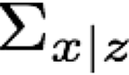
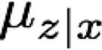
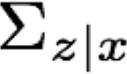

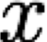
Variational Autoencoders
Decoder network inputs latent code z, gives distribution over data x
𝑝 _{θ} 𝑥 | 𝑧 = 𝑁(𝜇_{x|z}, Σ_{x|z})
Encoder network inputs data x, gives distribution over latent codes z
𝑞_{N} 𝑧 | 𝑥 = 𝑁(𝜇_{z|x}, Σ_{z|x})
If we can ensure that
𝑞 _{ϕ} 𝑧 𝑥) ≈ 𝑝 _{θ} 𝑧 𝑥),
then we can approximate
≈ 𝑝 _{θ} 𝑥 𝑧)𝑝(𝑧)
𝑞 _{ϕ} 𝑧 𝑥)
𝑝 𝑥
θ
Idea: Jointly train both encoder and decoder

Slide 64
Variational Autoencoders
𝑧)𝑝(𝑧)
𝑝 𝑧 𝑥)
𝑝 _{θ} 𝑥
log 𝑝 _{θ}(𝑥) = log
θ
Bayes’ Rule

Slide 65
Variational Autoencoders
𝑝 𝑥
𝑧)𝑝(𝑧) _{= log} 𝑝 _{θ} 𝑥 𝑧 𝑝 𝑧 𝑞 _{ϕ}(𝑧|𝑥)
log 𝑝 (𝑥) = log
θ
θ
𝑝 𝑧 𝑥)
𝑝 𝑧 𝑥 𝑞 (𝑧|𝑥)
θ
θ
ϕ
Multiply top and bottom by q_{Φ}(z|x)

Slide 66
Variational Autoencoders
𝑝 𝑥
𝑧)𝑝(𝑧) _{= log} 𝑝 _{θ} 𝑥 𝑧 𝑝 𝑧 𝑞 _{ϕ}(𝑧|𝑥)
log 𝑝 (𝑥) = log
θ
θ
𝑝 𝑧 𝑥)
𝑝 𝑧 𝑥 𝑞 (𝑧|𝑥)
θ
θ
ϕ
𝑞 _{ϕ} 𝑧|𝑥
𝑝(𝑧)
𝑞 _{ϕ}(𝑧|𝑥)
= log 𝑝
𝑥 𝑧
− log
^{+ log} 𝑝 (𝑧|𝑥)
θ
K
θ
Split up using rules for logarithms

Slide 67
Variational Autoencoders
𝑝 _{θ} 𝑥 𝑧)𝑝(𝑧) _{= log}
𝑝 _{θ} 𝑧 𝑥)
𝑝_{θ} 𝑥 𝑧 | 𝑝 𝑧 | 𝑞_{ϕ} (𝑧^{c} |𝑥)
log 𝑝 _{θ}(𝑥) = log
𝑝 _{θ} 𝑧 𝑥 𝑞 _{ϕ}(𝑧c |𝑥)
𝑞 _{ϕ} 𝑧|𝑥
𝑞 _{ϕ}(𝑧|𝑥)
= log
𝑝 _{θ} 𝑥 | 𝑧
− log
+ log
𝑝 (𝑧|𝑥)
𝑝(𝑧)
θ
Split up using rules for logarithms

Slide 68
Variational Autoencoders
𝑝 𝑥
𝑧)𝑝(𝑧) _{= log} 𝑝 _{θ} 𝑥 𝑧 𝑝 𝑧 𝑞 _{ϕ}(𝑧|𝑥)
log 𝑝 (𝑥) = log
θ
θ
𝑝 𝑧 𝑥)
𝑝 𝑧 𝑥 𝑞 (𝑧|𝑥)
θ
θ
ϕ
𝑞 _{ϕ} 𝑧|𝑥
𝑞 _{ϕ}(𝑧|𝑥)
= log 𝑝
𝑥 𝑧 − log
+ log
𝑝(𝑧) 𝑝 _{θ}(𝑧|𝑥)
θ
K
We can wrap in an expectation since it doesn’t depend on z
log 𝑝 _{θ} 𝑥
= 𝐸z~q ^{ϕ}(z|x)
log 𝑝 _{θ}(𝑥)

Slide 69
Variational Autoencoders
𝑝 𝑥
𝑧)𝑝(𝑧) _{= log} 𝑝 _{θ} 𝑥 𝑧 𝑝 𝑧 𝑞 _{ϕ}(𝑧|𝑥)
log 𝑝 (𝑥) = log
θ
θ
𝑝 𝑧 𝑥)
𝑝 𝑧 𝑥 𝑞 (𝑧|𝑥)
θ
θ
ϕ
𝑞 _{ϕ} 𝑧 𝑥
𝑞 _{ϕ}(𝑧|𝑥)
= 𝐸_{z}[log 𝑝 _{θ}(𝑥|𝑧)] − 𝐸_{z} log
+ 𝐸z log
𝑝 (𝑧|𝑥)
𝑝 𝑧
θ
We can wrap in an expectation since it doesn’t depend on z
log 𝑝 _{θ} 𝑥
= 𝐸z~q ^{ϕ}(z|x)
log 𝑝 _{θ}(𝑥)

Slide 70
Variational Autoencoders
𝑝 𝑥
𝑧)𝑝(𝑧) _{= log} 𝑝 _{θ} 𝑥 𝑧 𝑝 𝑧 𝑞 _{ϕ}(𝑧|𝑥)
log 𝑝 (𝑥) = log
θ
θ
𝑝 𝑧 𝑥)
𝑝 𝑧 𝑥 𝑞 (𝑧|𝑥)
θ
θ
ϕ
𝑞 _{ϕ} 𝑧 𝑥
𝑞 _{ϕ}(𝑧|𝑥)
= 𝐸_{z}[log 𝑝 _{θ}(𝑥|𝑧)] − 𝐸_{z} log
+ 𝐸_{z}
log
𝑝 (𝑧|𝑥)
𝑝 𝑧
θ
= 𝐸 _{z~q} ϕ_{(z|x)}[log 𝑝 _{θ}(𝑥|𝑧)] − 𝐷KL 𝑞 _{ϕ} 𝑧 𝑥 , 𝑝 𝑧
Data reconstruction
+ 𝐷KL(𝑞 _{ϕ} 𝑧 𝑥 , 𝑝 _{θ} 𝑧 𝑥 )

Slide 71
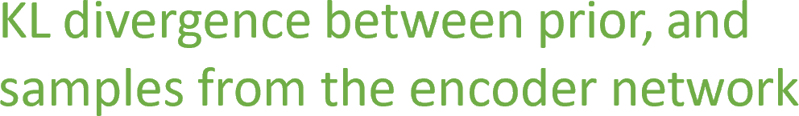
Variational Autoencoders
𝑝 𝑥
𝑧)𝑝(𝑧) _{= log} 𝑝 _{θ} 𝑥 𝑧 𝑝 𝑧 𝑞 _{ϕ}(𝑧|𝑥)
log 𝑝 (𝑥) = log
θ
θ
𝑝 𝑧 𝑥)
𝑝 𝑧 𝑥 𝑞 (𝑧|𝑥)
θ
θ
ϕ
𝑞 _{ϕ} 𝑧 𝑥
𝑞 _{ϕ}(𝑧|𝑥)
= 𝐸_{z}[log 𝑝 _{θ}(𝑥|𝑧)] − 𝐸_{z}
log
+ 𝐸_{z}
log
𝑝 (𝑧|𝑥)
𝑝 𝑧
θ
= 𝐸 _{z~q} ϕ_{(z|x)}[log 𝑝 _{θ}(𝑥|𝑧)] − 𝐷KL 𝑞 _{ϕ} 𝑧 𝑥 , 𝑝 𝑧
+ 𝐷KL(𝑞 _{ϕ} 𝑧 𝑥 , 𝑝 _{θ} 𝑧 𝑥 )
Notes:
KL Divergence measures difference between 2 gaussian (normal) distributions.

Slide 72
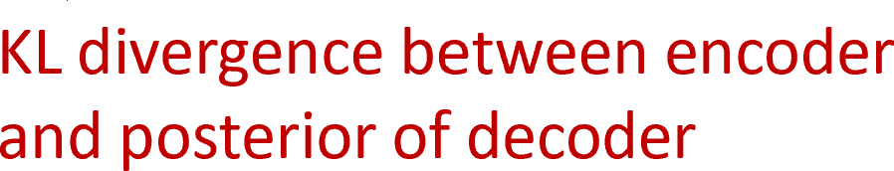
Variational Autoencoders
𝑝 𝑥
𝑧)𝑝(𝑧) _{= log} 𝑝 _{θ} 𝑥 𝑧 𝑝 𝑧 𝑞 _{ϕ}(𝑧|𝑥)
log 𝑝 (𝑥) = log
θ
θ
𝑝 𝑧 𝑥)
𝑝 𝑧 𝑥 𝑞 (𝑧|𝑥)
θ
θ
ϕ
𝑞 _{ϕ} 𝑧 𝑥
𝑞 _{ϕ}(𝑧|𝑥)
= 𝐸_{z}[log 𝑝 _{θ}(𝑥|𝑧)] − 𝐸_{z}
log
+ 𝐸_{z}
log
𝑝 (𝑧|𝑥)
𝑝 𝑧
θ
= 𝐸 _{z~q} ϕ_{(z|x)}[log 𝑝 _{θ}(𝑥|𝑧)] − 𝐷KL 𝑞 _{ϕ} 𝑧 𝑥 , 𝑝 𝑧
+ 𝐷KL(𝑞 _{ϕ} 𝑧 𝑥 , 𝑝 _{θ} 𝑧 𝑥 )

Slide 73
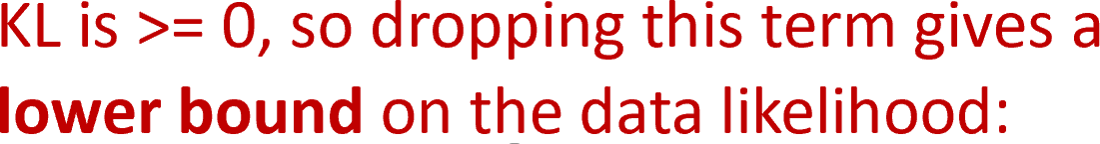
Variational Autoencoders
𝑝 𝑥
𝑧)𝑝(𝑧) _{= log} 𝑝 _{θ} 𝑥 𝑧 𝑝 𝑧 𝑞 _{ϕ}(𝑧|𝑥)
log 𝑝 (𝑥) = log
θ
θ
𝑝 𝑧 𝑥)
𝑝 𝑧 𝑥 𝑞 (𝑧|𝑥)
θ
θ
ϕ
𝑞 _{ϕ} 𝑧 𝑥
𝑞 _{ϕ}(𝑧|𝑥)
= 𝐸_{z}[log 𝑝 _{θ}(𝑥|𝑧)] − 𝐸_{z}
log
+ 𝐸_{z}
log
𝑝 (𝑧|𝑥)
𝑝 𝑧
θ
= 𝐸 _{z~q} ϕ_{(z|x)}[log 𝑝 _{θ}(𝑥|𝑧)] − 𝐷KL 𝑞 _{ϕ} 𝑧 𝑥 , 𝑝 𝑧
+ 𝐷KL(𝑞 _{ϕ} 𝑧 𝑥 , 𝑝 _{θ} 𝑧 𝑥 )

Slide 74
Variational Autoencoders
𝑝 𝑥
𝑧)𝑝(𝑧) _{= log} 𝑝 _{θ} 𝑥 𝑧 𝑝 𝑧 𝑞 _{ϕ}(𝑧|𝑥)
log 𝑝 (𝑥) = log
θ
θ
𝑝 𝑧 𝑥)
𝑝 𝑧 𝑥 𝑞 (𝑧|𝑥)
θ
θ
ϕ
𝑞 _{ϕ} 𝑧 𝑥
𝑞 _{ϕ}(𝑧|𝑥)
= 𝐸_{z}[log 𝑝 _{θ}(𝑥|𝑧)] − 𝐸_{z}
log
+ 𝐸_{z}
log
𝑝 (𝑧|𝑥)
𝑝 𝑧
θ
= 𝐸 _{z~q} ϕ_{(z|x)}[log 𝑝 _{θ}(𝑥|𝑧)] − 𝐷KL 𝑞 _{ϕ} 𝑧 𝑥 , 𝑝 𝑧
+ 𝐷KL(𝑞 _{ϕ} 𝑧 𝑥 , 𝑝 _{θ} 𝑧 𝑥 )
log 𝑝 _{θ} 𝑥 ≥ 𝐸 z~q ϕ(z|x)[log 𝑝 _{θ}(𝑥|𝑧)] − 𝐷KL 𝑞 ϕ 𝑧 𝑥 , 𝑝 𝑧
Notes:
Main idea: map a vector to an image (instead of mapping an image to an image).

Slide 75
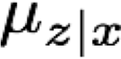





Variational
Autoencoders
Jointly train encoder q and decoder p to maximize the variational lower bound on the data likelihood
log 𝑝 _{θ}
𝑥 ≥ 𝐸 _{z~q} ϕ_{(z|x)}[log 𝑝 _{θ}(𝑥|𝑧)] − 𝐷_{KL} 𝑞 _{ϕ} 𝑧 𝑥 , 𝑝 𝑧
Encoder Network Decoder Network
𝑞 _{ϕ} 𝑧 | 𝑥 = 𝑁(𝜇_{z|x}, Σ_{z|x}) 𝑝 _{θ} 𝑥 | 𝑧 = 𝑁(𝜇_{x|z}, Σ_{x|z})

Slide 76


Generative Adversarial Nets
Review of the GAN:
min max 𝐸_{𝑥~𝑝𝑑𝑎𝑡𝑎(𝑥)} log 𝐷 𝑥
+ 𝐸_{𝑧~𝑞(𝑧)} log 1 − 𝐷 𝑧
𝐺 𝐷
A two-player game: 𝐺 wants to fool 𝐷 by creating an approximant distribution 𝑞 close to the true distribution 𝑝_{𝑑𝑎𝑡𝑎}, and 𝐷 wants to be smart so that it can distinguish between 𝑝_{𝑑𝑎𝑡𝑎} and 𝑞 induced by 𝐺.
Generator G
Discriminator D
Generated Image
Fake Or Real
Code z
Training Image
Notes:
Game always converges to be such that G can generate images that D cannot distinguish as being from the training data set.
This makes sense because G generates these images based on a flattened feature vector which is trained to generate an output as close to the input as possible.
Assumption is that G is a more powerful model than D.
Use case: DALLE 2 → generate an image as close to a real image as possible (i.e. up to some threshold determined by how powerful D is).
Stable Diffusion: same as autoencoder, but uses a mathematical approach for the encoding that does not require a neural net, so it is much faster and it is already commercialized and is the future for AI.

